Slide 1

Entity Relationship Diagram
Presented By:
Elizer Ponio Jr. Department of Computer Science
College of Computing and Information Technologies

Slide 2
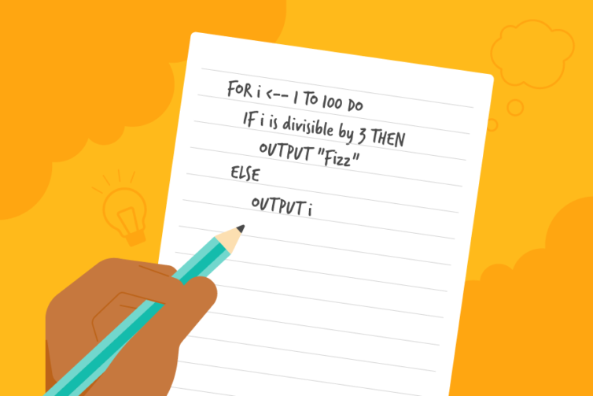
Introduction
When you discuss how a program works, showing the code may not be the easiest way of explaining it.
Especially if the person you are talking to is less familiar with the programming language you are using.
In these situations, you may want to express your program in pseudocode.

Slide 3
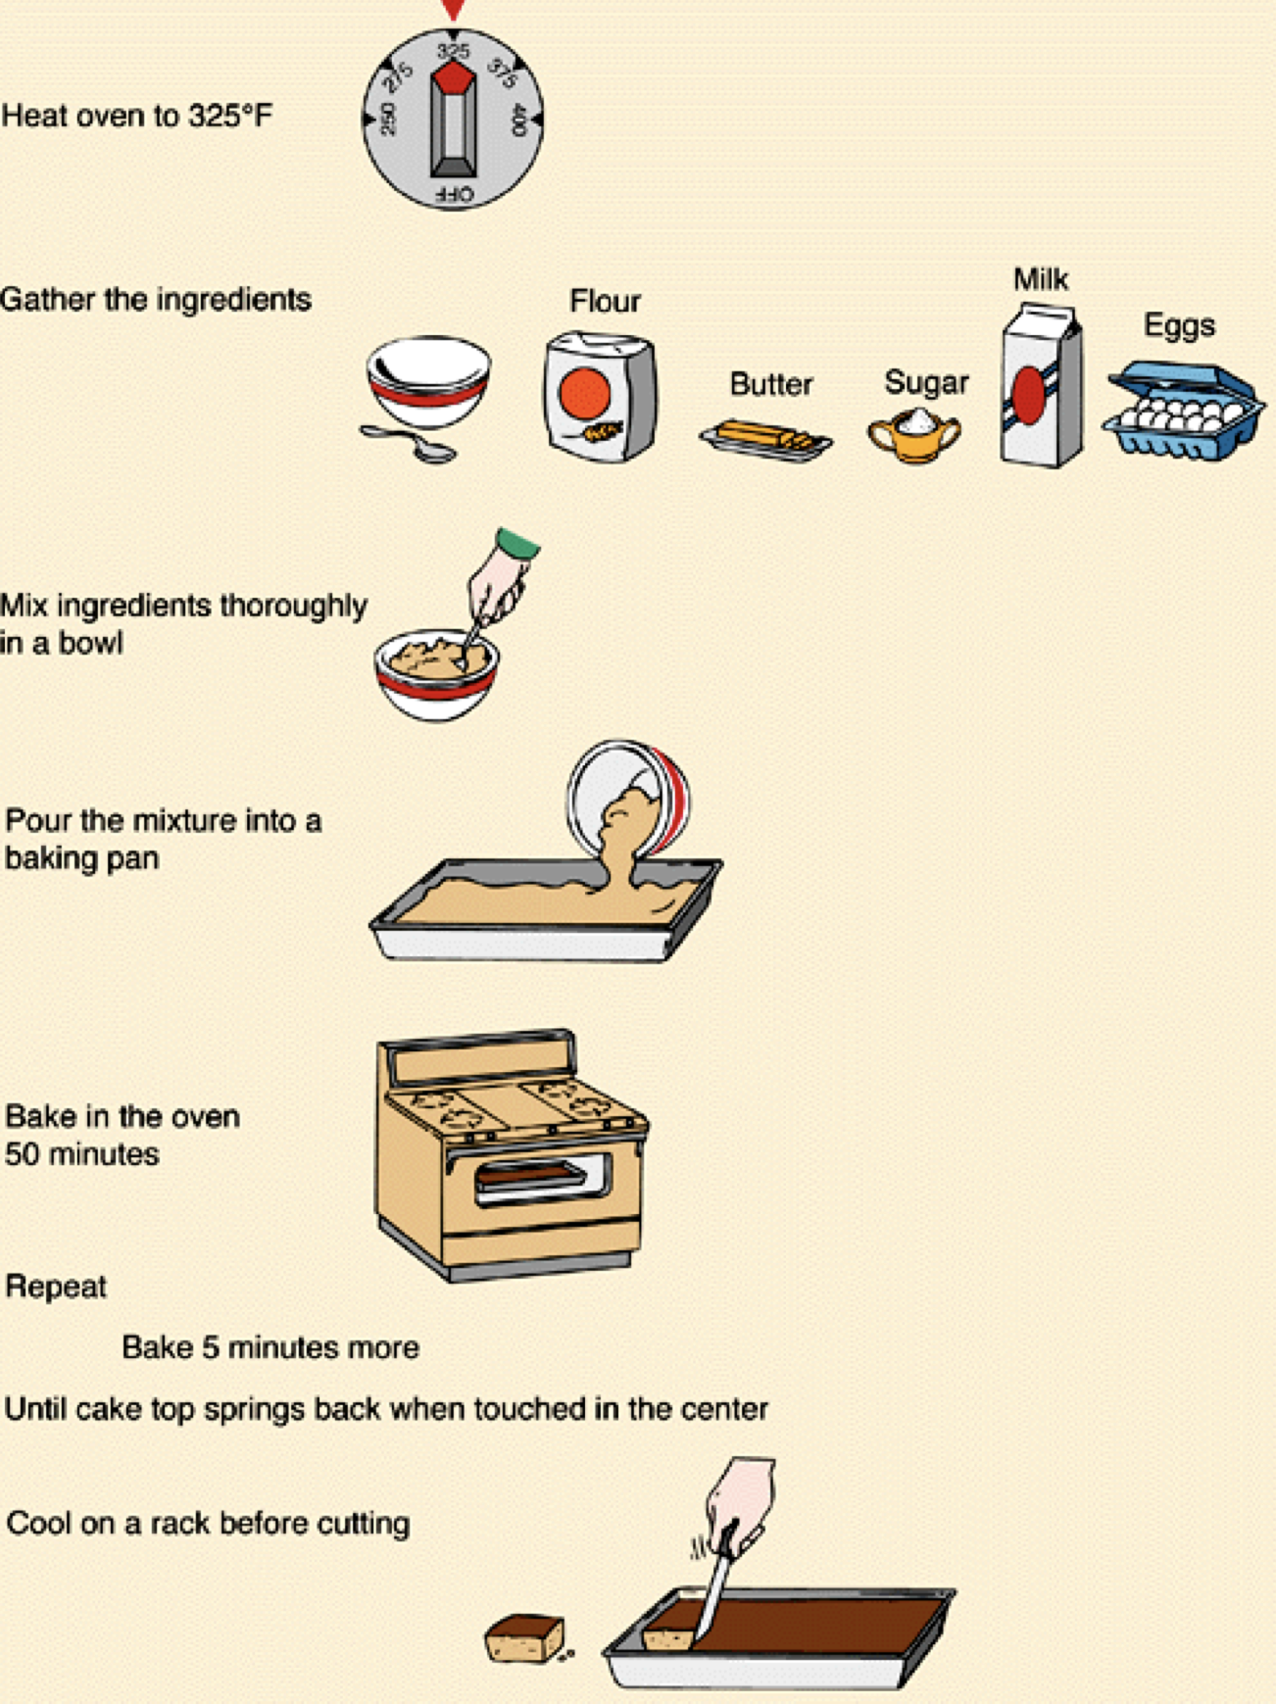

Slide 4
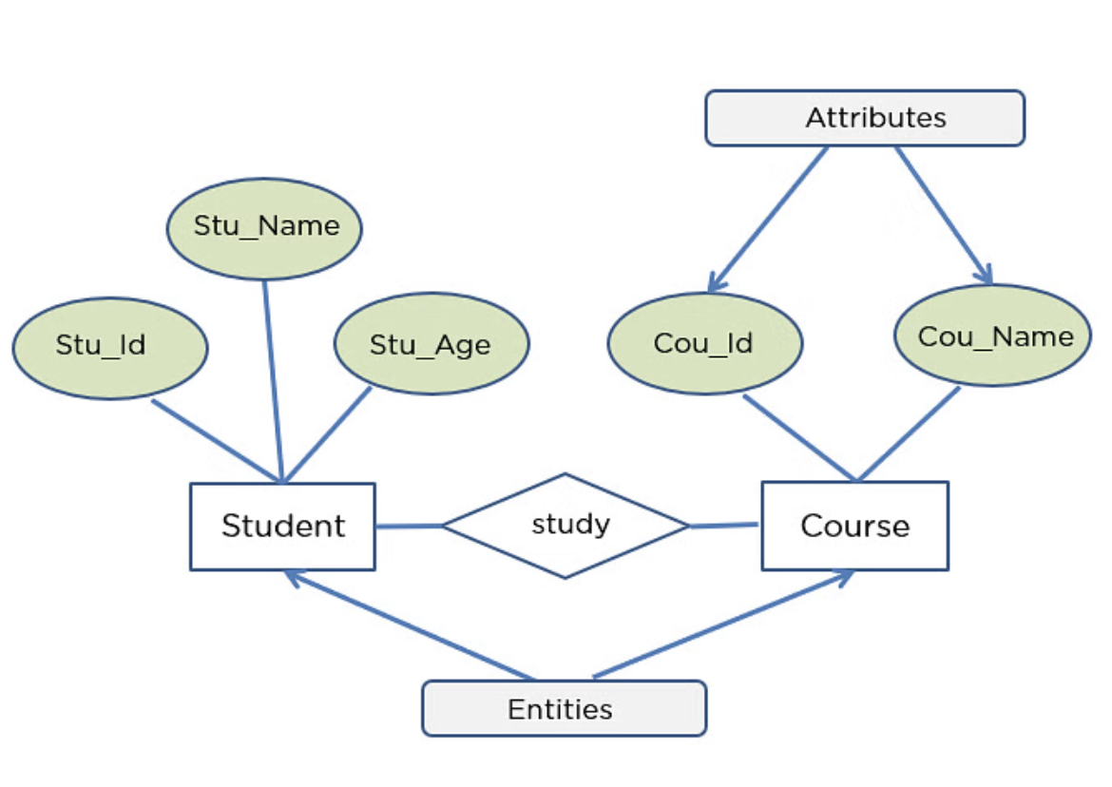
What is an Entity Relationship Diagram?
An Entity-relationship Diagram describes the relationship of entities that need to be stored in a database.
ER Diagram is mainly a structural design for the database. It is a framework using specialized symbols to define the relationship
ER diagram is created based on three main components, entities, attributes, and relationships.

Slide 5
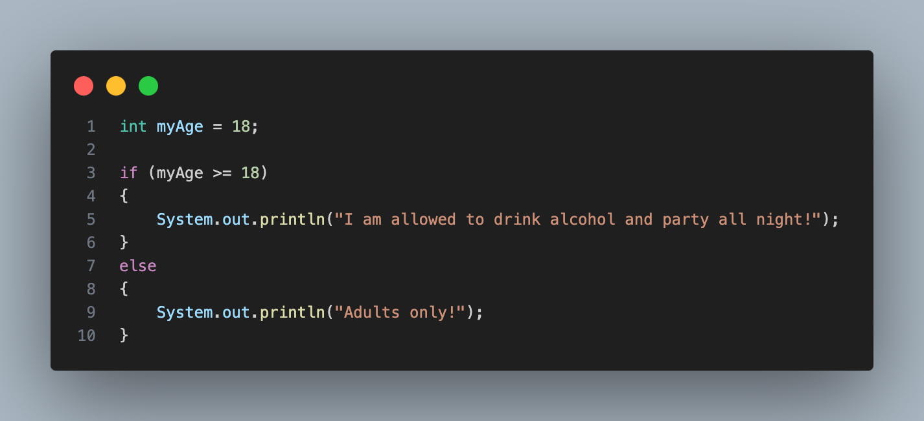
Converting Java Code to Pseudocode

Slide 6
Pseudocode:
myAge <-- 18
IF myAge is greater than or equal to 18 THEN
OUTPUT ”I am allowed to drink alcohol and party all night!”
ELSE
OUTPUT ” Adults only!”

Slide 7
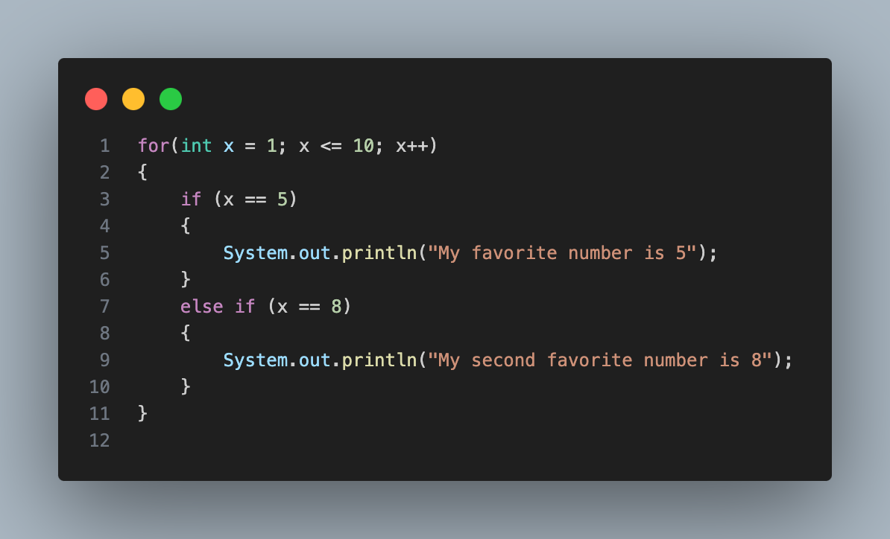

Slide 8
Pseudocode:
FOR x <-- 1 TO 10 DO
IF x is equal to 5 THEN
OUTPUT ”My favorite number is 5"
ELSE IF x is equal to 8 THEN
OUTPUT ”My second favorite number is 8"

Slide 9
How to write a pseudocode
Understand the problem.
Breakdown the problem into smaller steps
Write the pseudocode
Test the pseudocode
Translate the pseudocode into actual code.

Slide 10
Guidelines in writing Pseudocode
Use appropriate naming conventions. The human tendency follows the approach to follow what we see. If a programmer goes through a pseudo code, his approach will be the same as per it, so the naming must be simple and distinct.
Use appropriate sentence casings, such as CamelCase for methods, upper case for constants and lower case for variables.
Elaborate everything which is going to happen in the actual code. Don’t make the pseudo code abstract.

Slide 11
Guidelines in writing Pseudocode
Use standard programming structures such as ‘if-then’, ‘for’, ‘while’, ‘cases’ the way we use it in programming.
Check whether all the sections of a pseudo code is complete, finite and clear to understand and comprehend.
Don’t write the pseudo code in a complete programmatic manner. It is necessary to be simple to understand even for a layman or client, hence don’t incorporate too many technical terms.

